Slide 1
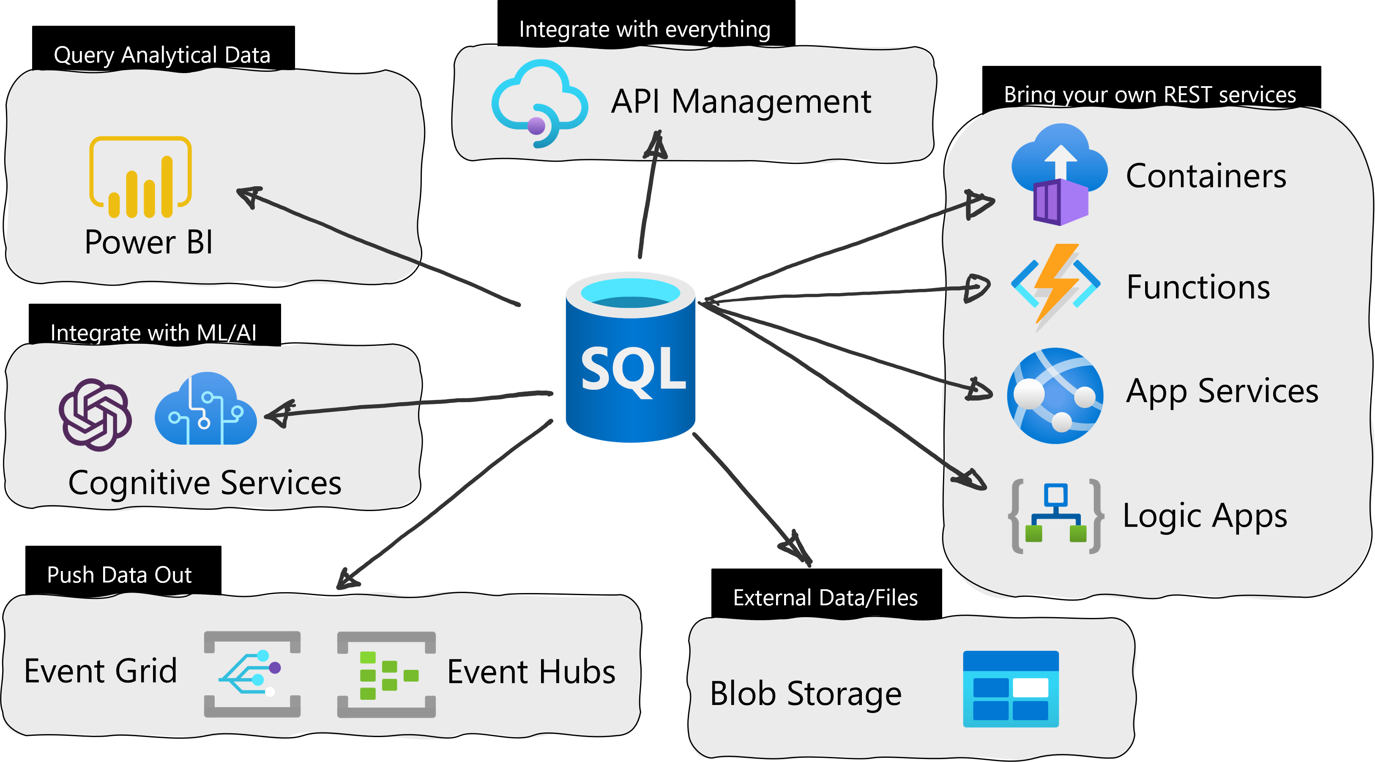
REST endpoint invocation

Slide 2
Examples
Interaction with a storage account:
Azure FileShare
Azure Container
Interaction with external resources:
Azure API Management

Slide 3
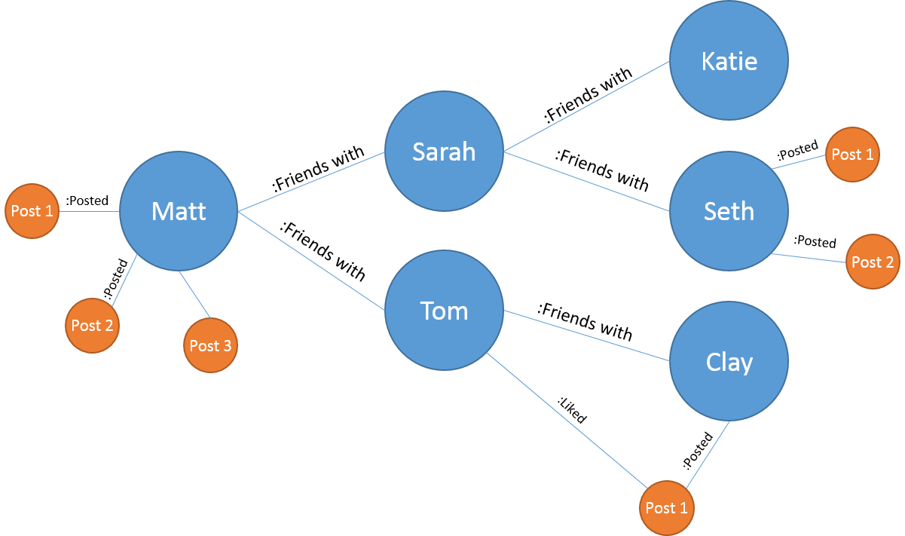
Graph Database on SQL Server
When should we use it?
Highly interconnected data
Flexible data scheme
Ease of access
Graph processing - SQL Server and Azure SQL Database | Microsoft Learn

Slide 4
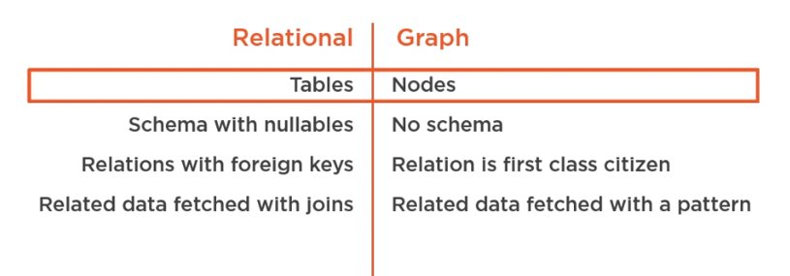
Relational vs Graph DB
A relational DB performs better when:
Data are highly structured
Computation are required on the single table
Analytics developed using group by

Slide 5
The social model
LocatedIn
Taco Dell (Restaurant)
John (Person)
Likes
LivesIn
FriendsOf
Bellevue (City)
Mary (Person)
Seattle (City)
Ginger and Spice (Restaurant)
Alice (Person)
Jacob (Person)
Redmond (City)
Julie (Person)
Noodle Land (Restaurant)

Slide 6
Questions
Find Restaurants that John likes
Find Restaurants that John’s friends like
Find people who like a restaurant in the same city they live in

Slide 7
Forum model – highly interconnected
Mike (ForumMember)
Likes
Carl (ForumMember)
Paul (ForumMember)
Christy (ForumMember)
Jennifer (ForumMember)
Charlie (ForumMember)
John (ForumMember)
Steve (ForumMember)

Slide 8
SHORTEST_PATH
Specifies a search condition for a graph, which is searched recursively or repetitively. SHORTEST_PATH can be used inside MATCH with graph node and edge tables, in the SELECT statement.
A shortest path between two given nodes/entities
Single source shortest path(s).
Shortest path from multiple source nodes to multiple target nodes.
‘+’: repeat the pattern 1 or more times. Terminate as soon as a shortest path is found
{1,n}: repeat the pattern 1 or n times. Terminate as soon as a shortest path is found
LAST_NODE(): allow you to chain two traversal path of arbitrary length
Aggregate functions: STRING_AGG, LAST_VALUE, SUM, COUNT, AVG, MIN, MAX
SHORTEST PATH (SQL Graph) - SQL Server | Microsoft Learn

Slide 9
Forum model – highly interconnected
Reply_To
Intro (ForumPosts)
Hi there this is ABC
Mike (ForumMember)
Likes
Intro (ForumPosts)
Hello I’m PQR
Carl (ForumMember)
Paul (ForumMember)
Re: Intro (ForumPosts)
Hey PQR this is XYZ
Christy (ForumMember)
Geography (ForumPosts)
Im George from USA
Re: Geography (ForumPosts)
I’m Mary from OZ
Jennifer (ForumMember)
Charlie (ForumMember)
Re: Geography (ForumPosts)
I’m Peter from UK
John (ForumMember)
Written_By
Intro (ForumPosts)
I’m Peter from UK
Steve (ForumMember)
Intro (ForumPosts)
Nice to see all here!

Slide 10
Try you!
T-SQL (Hard Skill)
Data Factory (Hard Skill)
Python (Hard Skill)
Valery (Person)
Leesa (Person)
Juliet (Person)
Lorenzo (Person)
Daycon (Person)
Frank (Person)
Saam (Person)

Slide 11
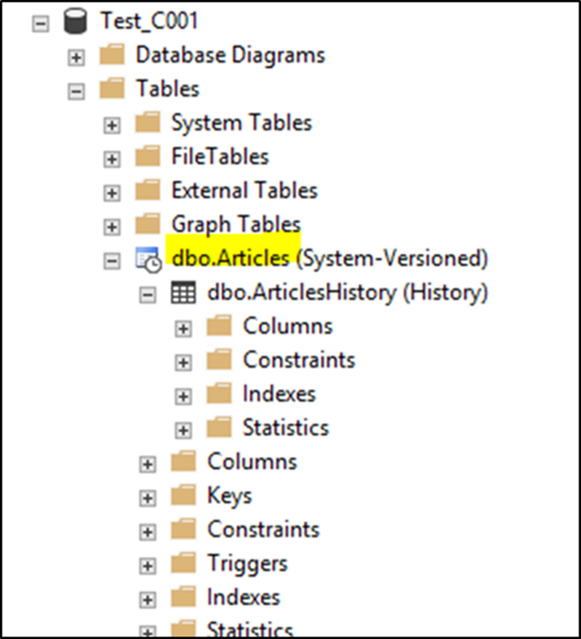
Temporal Table (system-versioned temporal tables)
https://learn.microsoft.com/en-us/sql/relational-databases/tables/temporal-tables?view=sql-server-ver16
Temporal tables are a database feature that bringsbuilt-in support for providing information about data stored in the table at any point in time, rather than only the data that is correct at the current moment in time.
Native functionality to historicize data
A twin table is created that stores the changed records
It is based on triggers and dedicated 'hidden' fields
Historical tables are compressed
It is possible to activate a retention value

Slide 12
Temporal Table (system-versioned temporal tables)
Useful for
Auditing
Historical Reports
Comparison between periods
Recovering from accidental data changes and application errors
Maintaining a slowly changing dimension for decision support applications

Slide 13
Temporal Table (system-versioned temporal tables)
The tables to become System Versioned must:
Having a primary Key
Have two fields of type datetime2 that are part of the SYSTEM_TIME period
There are several options to select to get data '' at a certain moment ''
The dates are stored as UTC (to filter for the local date use the AT TIME ZONE clause)
It is possible to historicize existing tables
The table structure can be changed. The changes are automatically propagated to the table with historical data.

Slide 14
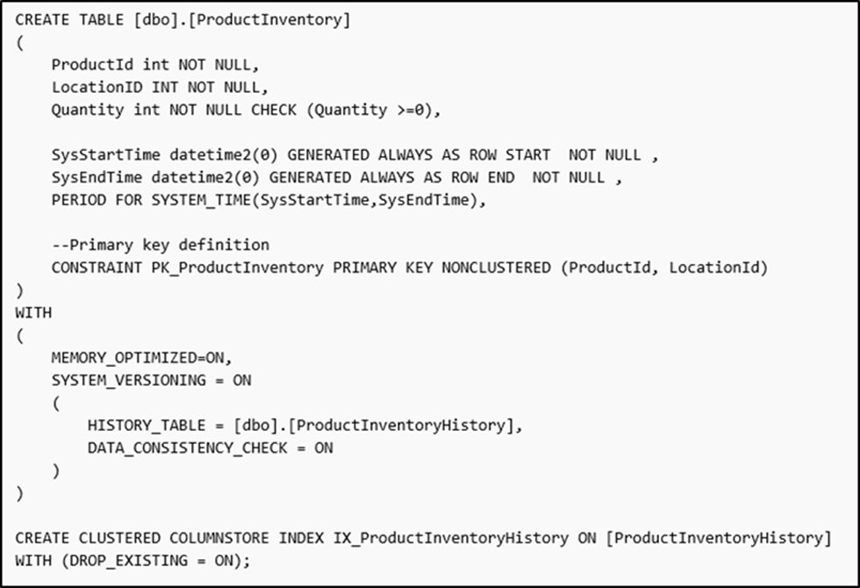
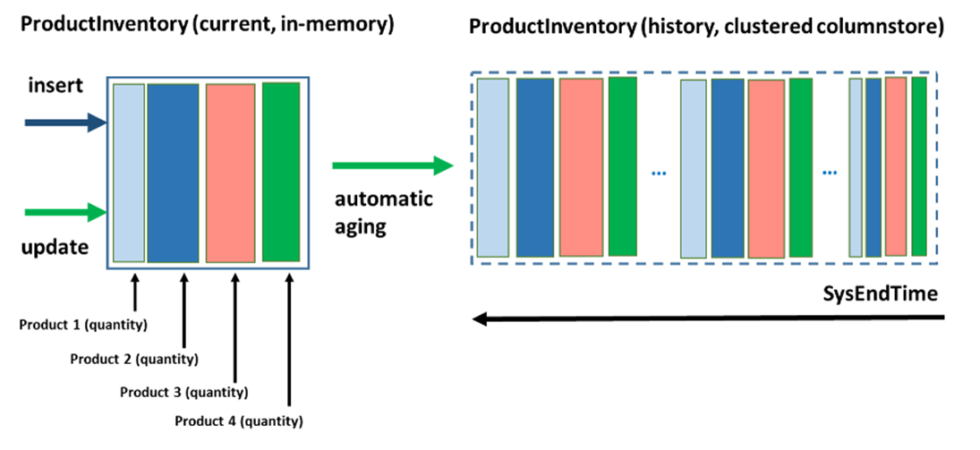

Temporal Table (system-versioned temporal tables)
Best Practice:
Index the table of historical data (evaluate Column Store Index)
Consider having the '' In Memory '' table

Slide 15
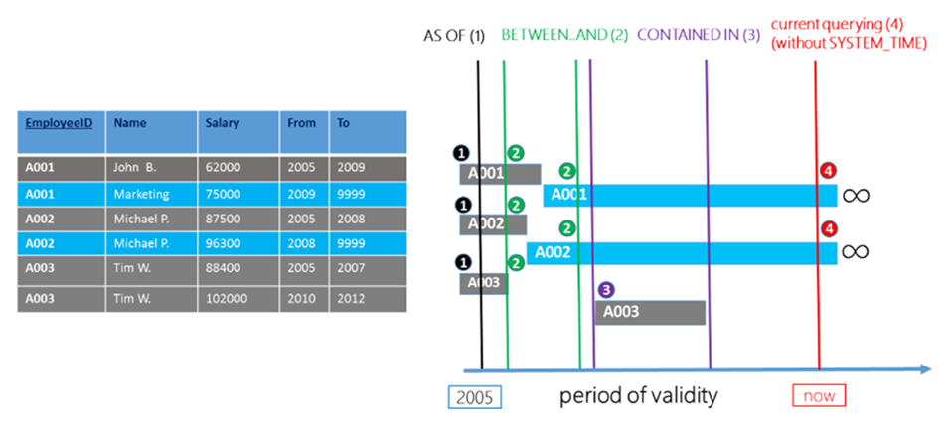
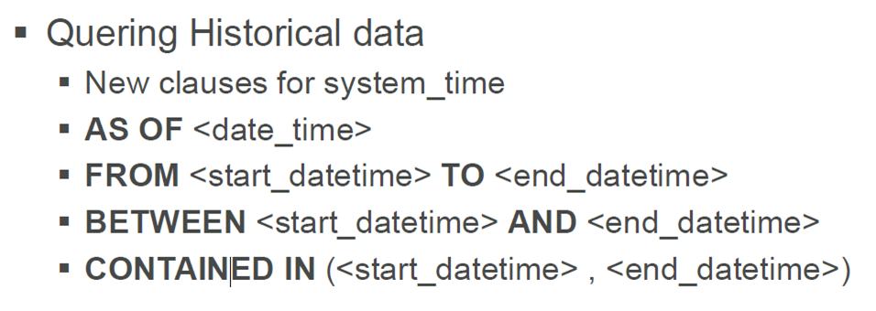
Temporal Table (system-versioned temporal tables)

Slide 16
Temporal Table (system-versioned temporal tables)
Some limitations:
It is not possible to make a TRUNCATE
The data in the historical table cannot be changed
It is not possible to add constraints to the historical table

Slide 17
Elastic Job
Elastic Job is an Azure resource that allows you to run scheduled Transact-SQL queries in your Azure SQL Databases.
It is similar to the SQL Server Agent in the On-prem SQL Server versions.
In Elastic Jobs, you can execute the scheduled tasks in multiple Azure SQL Servers, multiple Databases, and multiple Elastic Pools.
Servers and pools are dynamically enumerated at runtime, so jobs run against all databases that exist in the target group at the time of execution (SQL Server Agent could not do it)
The execution performs parallelly.

Slide 18
Elastic Job
Useful to:
Automate management tasks and schedule them to run every weekday, after hours, etc.
Configure jobs to execute across a collection of databases on a recurring basis, such as during off-peak hours.
Collect data for reporting
Data movement (ETL)

Slide 19
Elastic Job components
Component | Description
Elastic job agent | The Azure resource you create to run and manage Jobs.
Job database | A database in Azure SQL Database that the job agent uses to store job related data, job definitions, etc.
Job | A job is a unit of work that is composed of one or more job steps. Job steps specify the T-SQL script to run, as well as other details required to execute the script.
Target group | The set of servers, pools, and databases to run a job against.

Slide 20
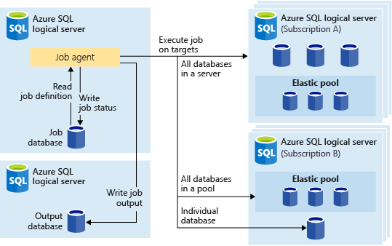
Elastic Job

Slide 21
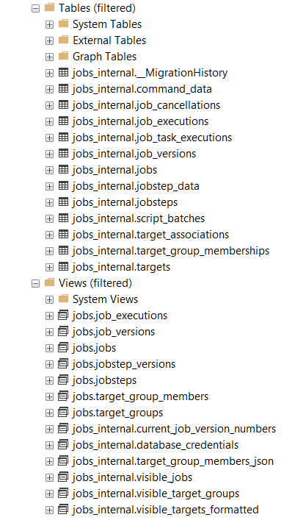
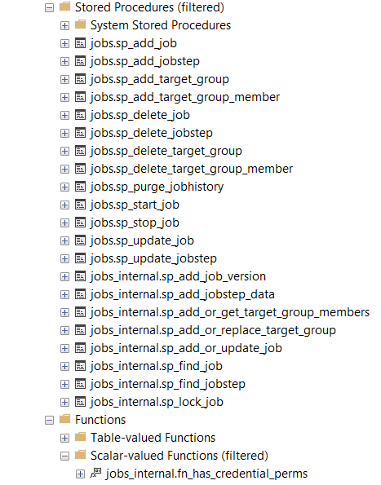
Elasticjobs: schema jobs_internal

Slide 22
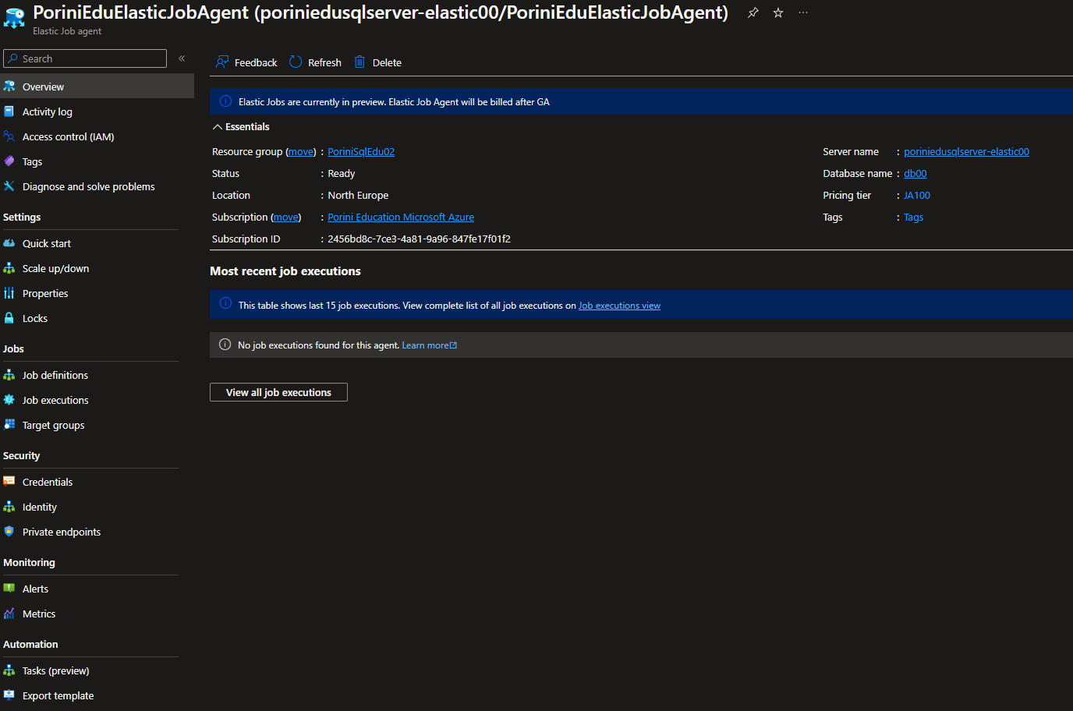

Slide 23
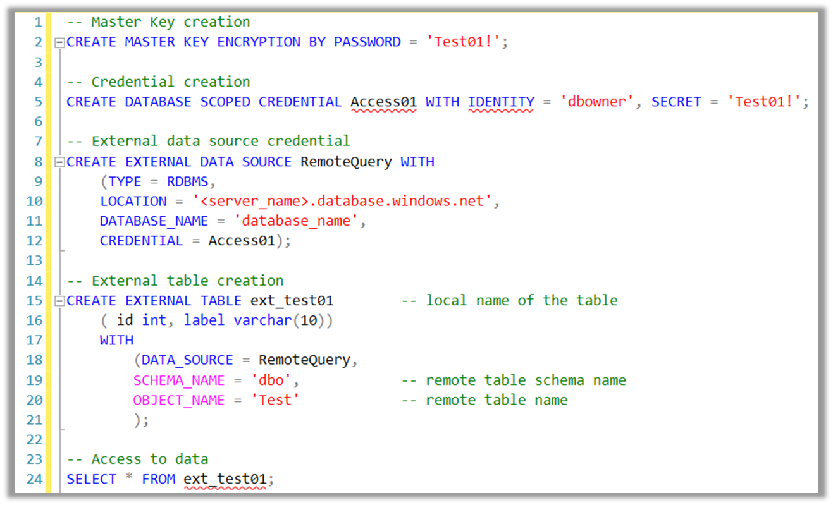
Cross Azure Database Query
Azure SQL Database doesn’t allow the use of the linked server (instance-level service)
The databases, even if they are connected to the same server, are independent
To provide the DML through different databases, we have to use the PolyBase service instance-level

